Slide 1
Wilson Financial Case Study
Echo Group

Slide 2
Members: Andreas Arnet Michael Lohr Mick Welisevich Shawn Roberts Walter Dipping

Slide 3
Wilson Financial Case Study Summary
Investment firm with four employees
Two owners
One Compliance Manager
One office assistant
Looking to evaluate:
New clients (past 6 months)
Average assets across all clients
Count of high transaction(10+)

Slide 4
Background:
Jake and Ned Willson have always been interested in finance and investment.
Understanding that there are many ranchers and farmers that do a good business, and seeing more and more people retiring to the area, they started on a business plan to open up Willson Financial.
When they started running Willson Financial, they hired one office employee; Phoenix Two Star, who would take care of client appointments, office supplies, and other office duties. They also hired a part-time compliance manager, June Santos, to ensure that the company would stringently follow all regulations required by the SEC, with whom the company is registered.
While Jake and Ned know that the customer list has grown in the past year, they’ve been so busy that they decided it was time to step back, look at the client list, their assets, and the billing process to make sure the customers were getting the best service possible, while keeping the business running

Slide 5
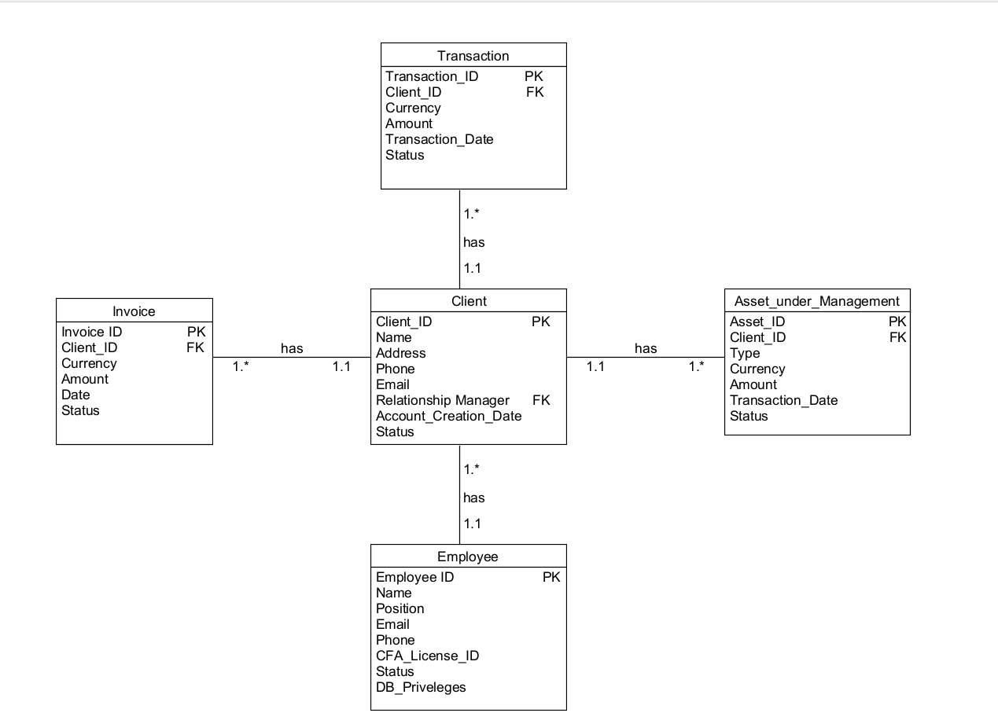
Echo Group ORD

Slide 6
Assumptions made:
New clients are saved in table Client; every client gets a Relationship Manager assigned (column Relationship_Manager in table Client)
Client transfers money to Willson Financial; the transfer is saved in table Transaction
Willson Financial invests the client’s money; however, not necessarily the whole amount at once. Every investment is saved in table Asset_under_Management
The invoice is created based on the client’s average Asset under Management and the number of transactions
The Invoice is based on the number of transactions (fixed amount per transaction) AND average Assets under Management
If assets are disinvested, the status of the respective entry in table Asset_under_Management is changed to “disinvested”
Because June does not have a CFA, she does not have access to all records the way Jake and Ned do à The database privileges are defined in column DB_Privileges in table Employee

Slide 7
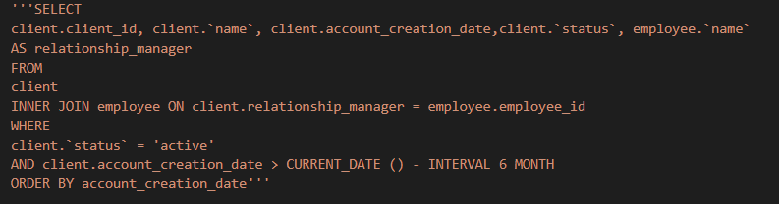
Report 1 question to be answered: How many clients have been added for each of the past six months?
Query Python code:

Slide 8
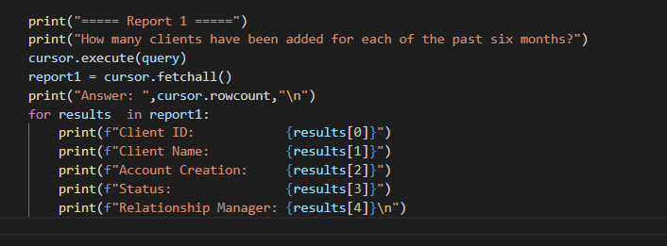
Report 1: Format to Output:

Slide 9
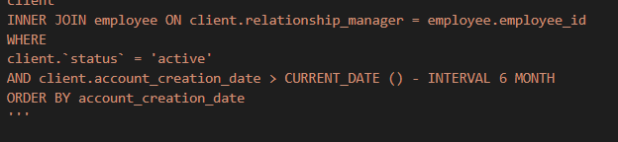
Report 1 breakdown:
The INNER JOIN returns all rows from both the participating tables where the key record of one table is equal to the key records of another table (employee_id)
The where clause filters the retrieval of the SELECT statement to only return accounts less than six months from the query submission date.
The Python method cursor.rowcount is a read-only property that returns the number of rows affected by the DML statement (SELECT).
Answers the number of accounts established in the past 6 months.

Slide 10


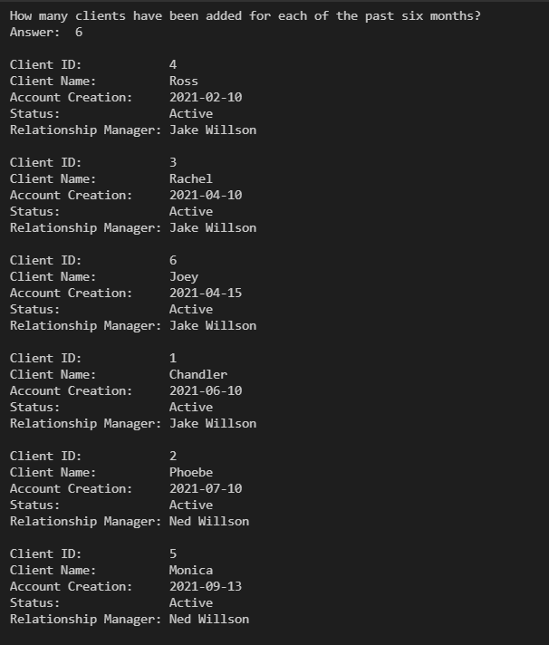

Report 1 Output:
z

Slide 11
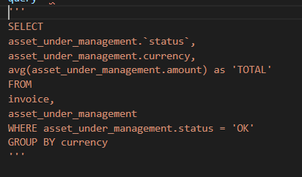
Report 2 question to be answered: What is the average amount of assets (in currency) for the entire client list?
Query Python Code:

Slide 12
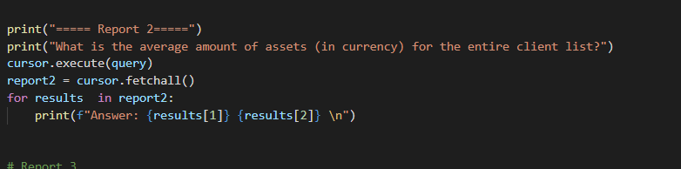
Report 2: Format for Output:

Slide 13
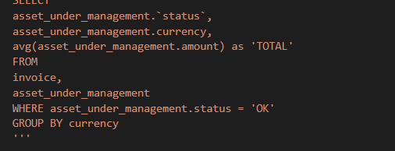

Report 2 breakdown:
The avg() function in the SELECT clause retrieves the average numeric value of desired information..
The GROUP BY returns a single row from within the query having the same column values (currency). Its main purpose is to work alongside the average function for summation retrievals.
SELECT clause retrieves two results: result[1] = Currency
result[2] = Average from the Total report.
For loop allots results to the formatted output.

Slide 14

Report 2 Output:

Slide 15
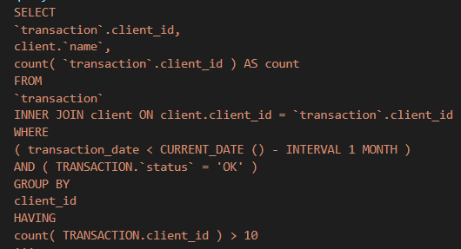
Report 3 question to be answered: How many clients have a high number (more than 10 a month) of transactions?
Query Python code:

Slide 16
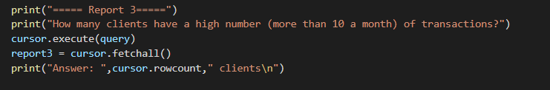
Report 3: Format for Output:

Slide 17
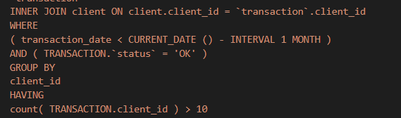

Report 3 breakdown:
The INNER JOIN returns all rows from both the participating tables where the key record of one table is equal to the key records of another table (client_id)
The GROUP BY with HAVING clause retrieves the result for a specific group of a column, which matches the condition specified in the HAVING clause. (Less than 10 transaction in interval period)
cursor.rowcount returns the number of rows affected by DML statement (SELECT)

Slide 18

Report 3 Output:

